Slide 1
p
roject
hotell
E
presented by
karim Atef

Slide 2

OBJECTIVE
It is the design and implementation of a machine learning model for a hotel to predict whether the booking will be canceled or not.
PROBLEM STATEMENT
Goal: He did the classification correctly.

Slide 3
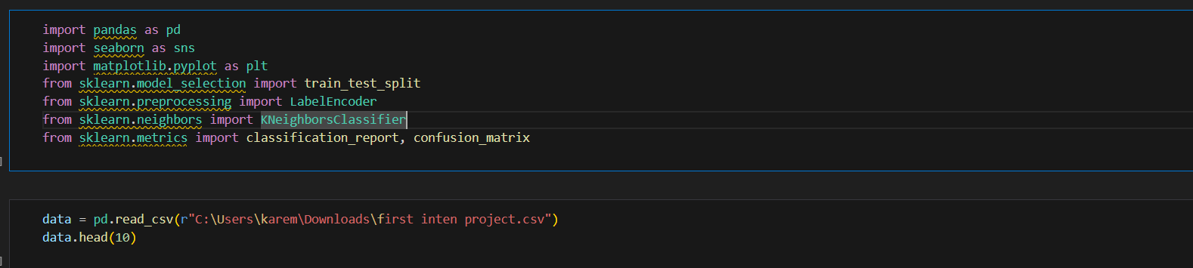

FIRST
STEP
IMPORT DATA AND LIBRARYS
pandas : To maintain and retrieve the data
seaborn , matplotlib : To create a visualization for the data
train_test_splite : To split the data into test data and train data
KNeighborsClassifier : To create a model of type KNN
Confusion_matrix : He is doing a test for the model.
Users book their productivity pod through the app, specifying preferences like light intensity, noise levels, or sensory needs.
The pod adjusts settings automatically via AI algorithms and IoT integration.
On-demand ordering for food, beverages, or additional services is available through the app.

Slide 4
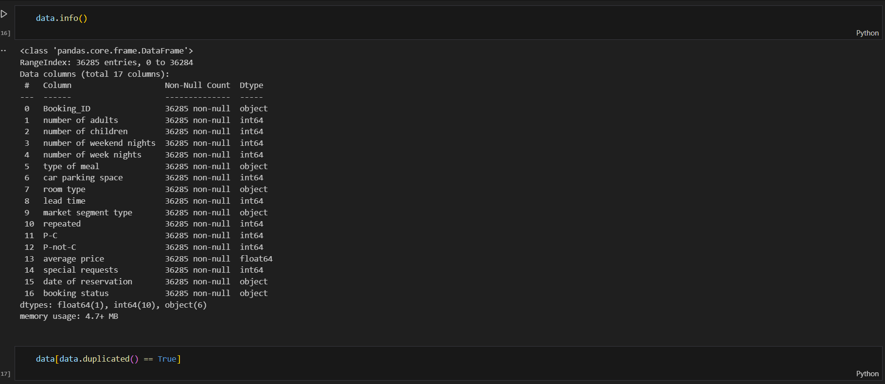
DATA EXAMINATION AND PROCESSING
NULL CHECK
Null does not exist in the data.
DUPLICATED CHECK
There are no duplicates.
CHECK DATA TYPE
The type of data for the date of reservation is incorrect and we will change it to date, time, but we faced some problems that there is a date of 2018-2-29 which is wrong, so I replaced it with 1/3/2018.

Slide 5
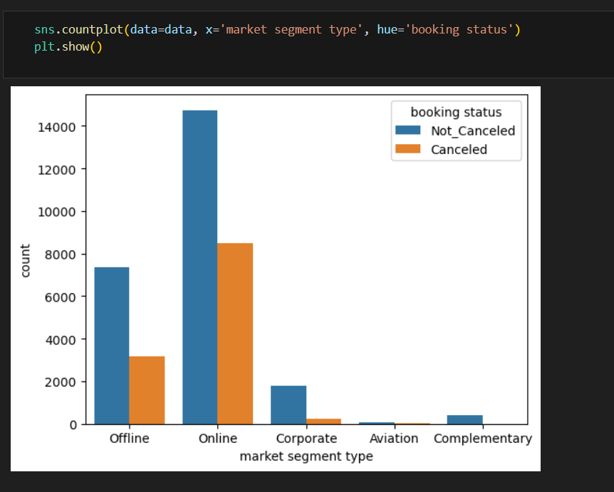
DATA
ANALYSIS
# Here I wanted to study if there is a relationship between 'booking status' and 'market segment type'.
In that case, it turned out that the highest number of bookings was online, and there was a higher number of cancellations.
Also, the difference between 'canceled' and 'not canceled' is in 'complementary.'
# It is clear that the 'market segment type' affects the 'booking status,' so we will take the 'market segment type.'

Slide 6
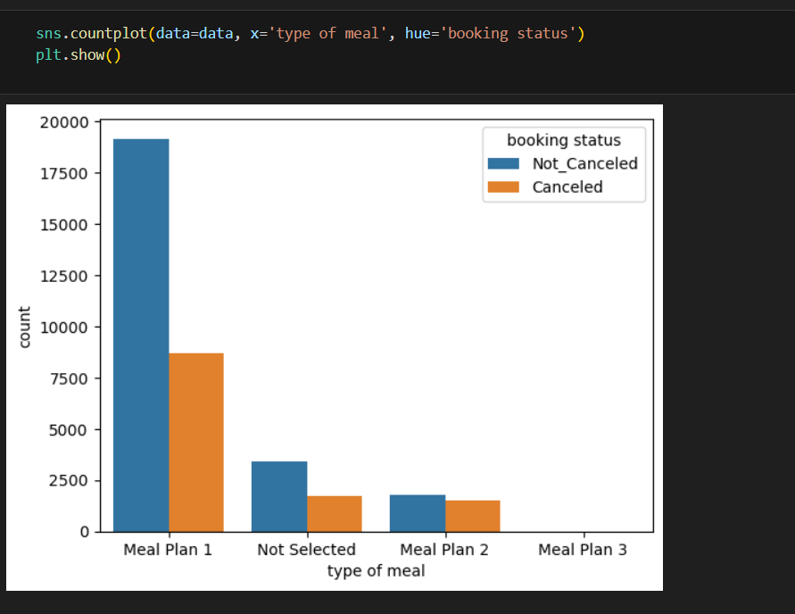
# HERE I WANTED TO STUDY IF THERE IS A RELATIONSHIP BETWEEN 'BOOKING STATUS' AND 'TYPE OF MEAL' BY BAR PLOT.
It is clear that plan 1 is the best in terms of performance and that plan 2 is less efficient regarding the difference between canceled and not canceled.
Plan 3 is to be the least plan in terms of quantity and may reach zero.
# It is clear that the 'type of meal' affects the 'booking status’.

Slide 7
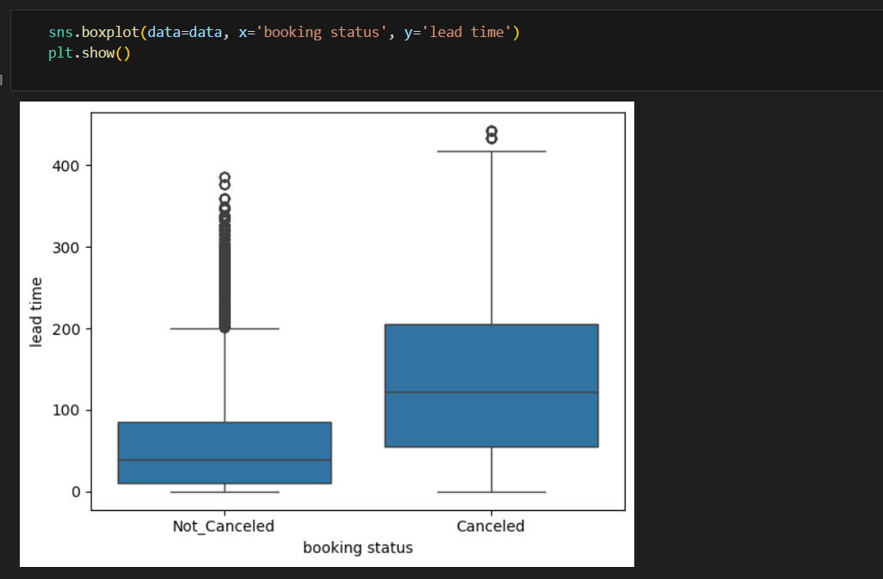
# HERE I WANTED TO STUDY IF THERE IS A RELATIONSHIP BETWEEN 'BOOKING STATUS' AND 'LEAD TIME' BY BOX PLOT.
It is clear that the longer the lead time, the higher the number of cancellations.
It is clear that the shorter the lead time, the higher the number of Not_canceled.

Slide 8
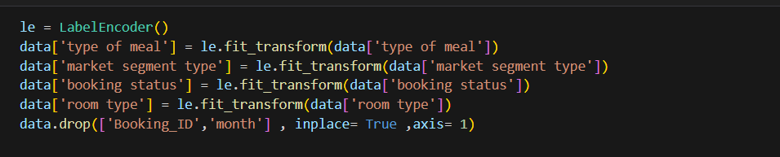
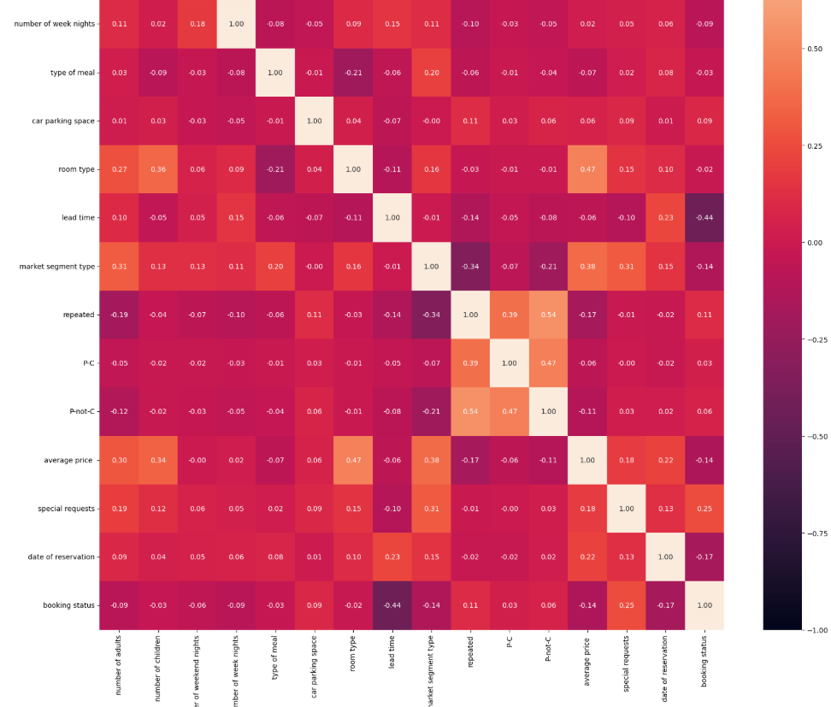
This is to do encoding for the column categories because the KNN model cannot accept non-numeric data.
_____________________________________________________________________________________________________________________________________
colum | correlation
date of reservation | -0.17
special requests | 0.25
average price | -0.14
p-not-c | 0.06
p-c | 0.03
repeated | 0.11
market segment type | -0.14
lead time | -0.44
This heatmap represents the correlation between the column and then.

Slide 9
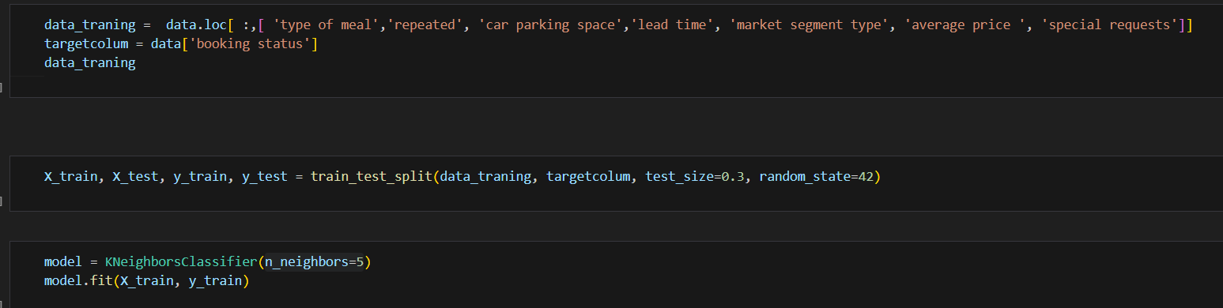
SELECT BEST COLUMES
BEST COLUMS
SPLIT DATA
'type of meal' , 'repeated' , 'car parking space' , 'lead time' , 'market segment type' , 'average price ' , 'special requests'
Here I did a split of the data with a 70 to 30 ratio, and this was the best ratio used.
TRAIN MODEL
I chose here that it takes 5 from neighbors because it was giving the best result.

Slide 10
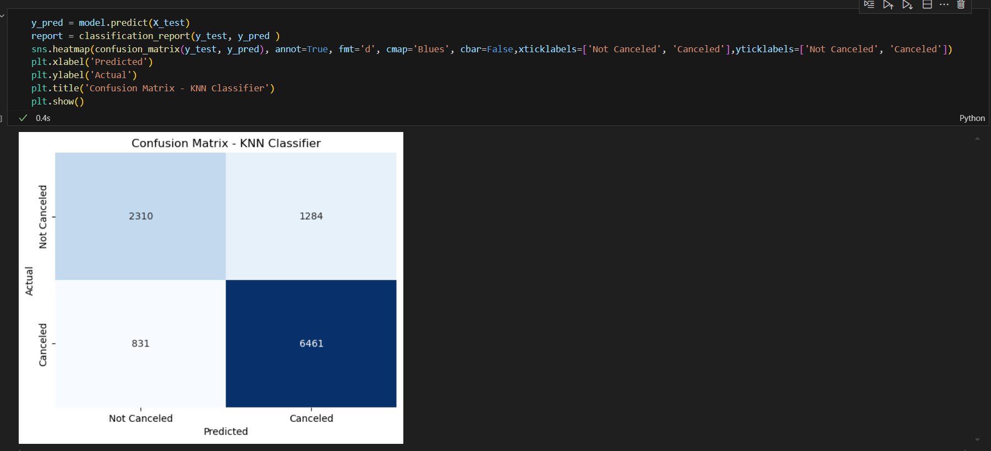
EVALUATING THE MODEL
HIS RESULTS
It is clear that the model predicts canceled cases very accurately, as it predicted 6461 correctly and 2310 correctly for not canceled cases.

Slide 11
PRESENTED BY :
karem atef
THANKS
karem atef

